Slide 1

EDA PROJECT PRESENTED BY GROUP 3 WORLD UNIVERSITY RANKINGS
Prepared by:
WAKILU OLOYADE
MOSES YISA
BUSAYO OLANSEBE
TEMITAYO DARAMOLA
Submitted To:
10Alytics

Slide 2
EXECUTIVE SUMMARY
According to Quacquarelli Symonds (QS), 2023 World University Rankings include 1,500 institutions from around the world. It’s not just the supreme institutions that take the top spots: this year’s highest rankings include universities from diverse locations across Europe, Asia and North America
From this statement, it is crucial to ask the following questions:
Which Institution will be ranked first among the world universities?
Top countries that made the list
Where is the best University located?
What are the things to be done by other universities to become the best ranked?

Slide 3
DATA SET
Data was extracted from Kaggle.com
Data link
https://www.kaggle.com/code/felixhuang123/qs-university-ranking-eda/data
The dataset consists of a list of 1500 world Universities.
The list cut across several countries in Europe, Asia, North America, etc
Several key indicators were used, these are:
Accelerated Reader (Ar score and Ar rank), Financial Strength Rating (fsr score and fsr rank), Crowd-Sourced Peer Feedback (cpf score and cpf rank), etc

Slide 4
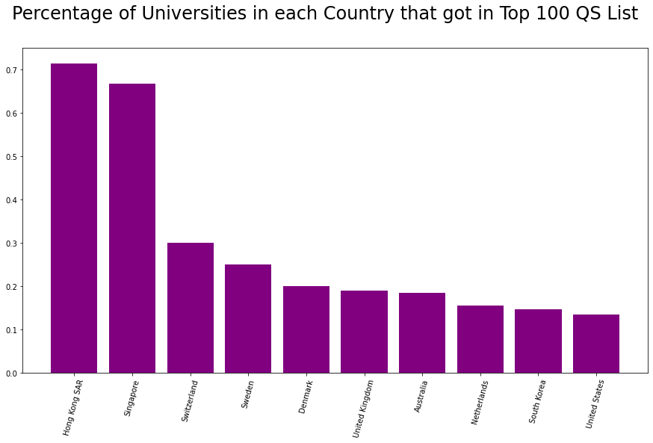
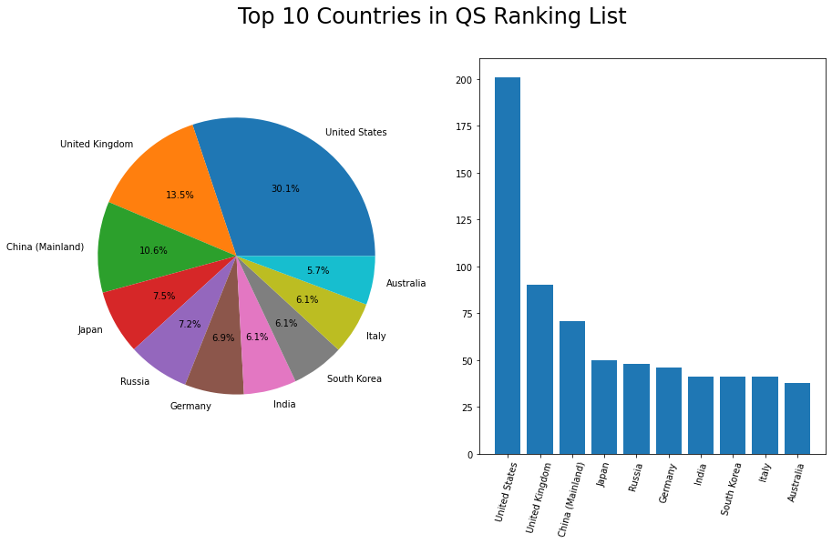
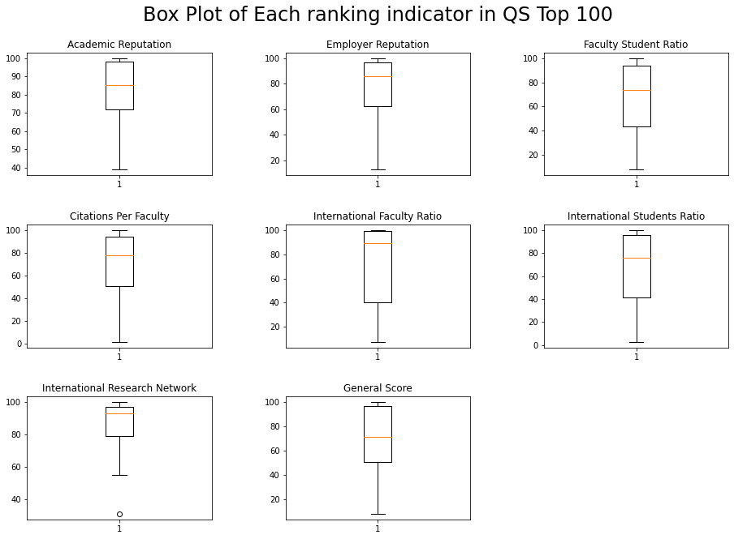
VISUALIZATION

Slide 5
CONCLUSION
Based on the box plots interpretation: These Universities are in Top 100 because of their high Academic reputation, Employer reputation, Citations per Faculty, International Students and Research ratio. Based on these, students tend to choose these Top 100 Universities over other Universities that are least ranked.
Hong Kong, Singapore, Switzerland, Sweden and Denmark are the countries with the highest percentage of Universities in the top 100.
While US, UK, China, Japan, Russia, Germany, India, South Korea, Italy and Australia are the top 10 countries with the highest number of Universities
Top 10 Universities
Massachusetts Institute of Technology (MIT) – US
University of Cambridge – UK
Stanford University – US
University of Oxford – UK
Harvard University – US
California Institute of Tech – US
Imperial College London – UK
UCL – UK
ETH Zurich-Swiss Fed Inst of Tech – Switzerland
University of Chicago – US

Slide 6

THANK YOU

